Slide 1


Slide 2
Variable
Variable is a name of memory location. There are three types of variables in java: local, instance and static.
There are two types of data types in java: primitive and non-primitive.

Slide 3
Variable
Variable is name of reserved area allocated in memory. In other words, it is a name of memory location. It is a combination of "vary + able" that means its value can be changed.
int data=10;//Here data is variable

Slide 4
Types of Variable
There are three types of variables in java:
local variable
instance variable
static variable

Slide 5
1)Local Variable
A variable which is declared inside the method is called local variable.
2) Instance Variable
A variable which is declared inside the class but outside the method, is called instance variable . It is not declared as static.
3) Static variable
A variable that is declared as static is called static variable. It cannot be local.

Slide 6
Example to understand the types of variables in java
class A{
int data=50;//instance variable
static int m=100;//static variable
void method(){
int n=90;//local variable
}
}//end of class

Slide 7
Boolean
EXAMPLE
class BooleanExample
{
public static void main(String[] args)
{
boolean flag = true; System.out.println(flag);
}
}
output: TRUE
The boolean data type has two possible values, either true or false.
Default value: false.
They are usually used for true/false conditions.

Slide 8
byte
class ByteExample
{
public static void main(String[] args)
{
byte range; range = 124; System.out.println(range); // Error code below. Why? // range = 200
}
}
output: 124
The byte data type can have values from -128 to 127 (8-bit signed two's complement integer).
It's used instead of int or other integer data types to save memory if it's certain that the value of a variable will be within [-128, 127].
Default value: 0

Slide 9
short
class ShortExample
{
public static void main(String[] args)
{
short temperature; temperature = -200; System.out.println(temperature);
}
}
output: -200
The short data type can have values from -32768 to 32767 (16-bit signed two's complement integer).
It's used instead other integer data types to save memory if it's certain that the value of the variable will be within [-32768, 32767].
Default value: 0

Slide 10
Char
class CharExample
{
public static void main(String[] args)
{
char letter = '\u0051'; System.out.println(letter);
}
}
Output: q
You get the output Q because the Unicode value of Q is '\u0051'.
It's a 16-bit Unicode character.
The minimum value of char data type is '\u0000' (0). The maximum value of char data type is '\uffff'.
Default value: '\u0000'

Slide 11
Data Types in Java
Data types represent the different values to be stored in the variable. In java, there are two types of data types:
Primitive data types
Non-primitive data types

Slide 12
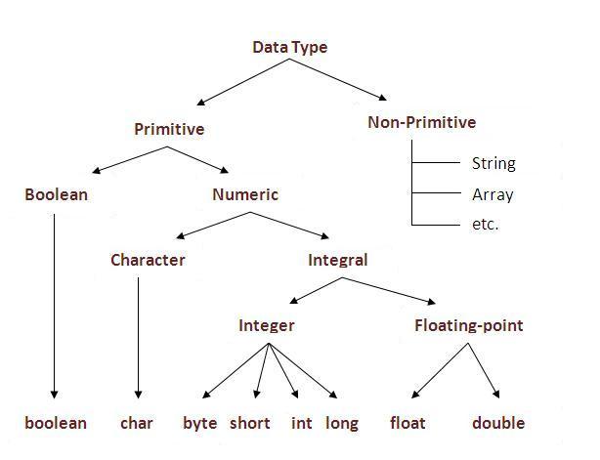

Slide 13
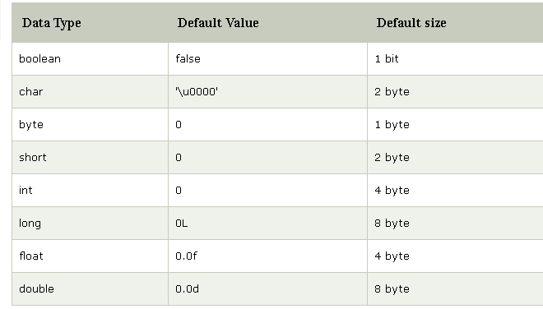

Slide 14
Why char uses 2 byte in java and what is \u0000 ?
It is because java uses Unicode system than ASCII code system. The \u0000 is the lowest range of Unicode system.

Slide 15
Java Variable Example: Add Two Numbers
class Simple{
public static void main(String[ ] args)
{
int a=10;
int b=10;
int c=a+b;
System.out.println(c);
}
}
Output: 20

Slide 16
Java Variable Example: Widening
class Simple{
public static void main(String[] args)
{
int a=10;
float f=a;
System.out.println(a);
System.out.println(f);
}
}
Output:
10
10.0

Slide 17
Java Variable Example: Narrowing (Typecasting)
class Simple{
public static void main(String[] args)
{
float f=10.5f;
//int a=f;//Compile time error
int a=(int)f;
System.out.println(f);
System.out.println(a);
}}
Output:
10.5
10

Slide 18
Java Variable Example: Overflow
class Simple{
public static void main(String[] args)
{
//Overflow
int a=130;
byte b=(byte)a;
System.out.println(a);
System.out.println(b);
}}
Output:
130
-126

Slide 19
Java Variable Example: Adding Lower Type
class Simple{
public static void main(String[] args)
{
byte a=10;
byte b=10;
//byte c=a+b;//Compile Time Error: because a+b=20 will be int
byte c=(byte)(a+b);
System.out.println(c);
}}
Output:
20

Slide 20
OPERATORS IN JAVA
Operator in java is a symbol that is used to perform operations. For example: +, -, *, / etc.
There are many types of operators in java:
Unary Operator,
Arithmetic Operator,
shift Operator,
Relational Operator,
Bitwise Operator,
Logical Operator,
Ternary Operator and
Assignment Operator.

Slide 21
Operator Type | Category | Precedence
Unary | postfix | expr++ expr--
 | prefix | ++expr --expr +expr -expr ~ !
Arithmetic | multiplicative | * / %
 | additive | + -
Shift | shift | << >> >>>
Relational | comparison | < > <= >= instanceof
 | equality | == !=
Bitwise | bitwise AND | &
 | bitwise exclusive OR | ^
 | bitwise inclusive OR | |
Logical | logical AND | &&
 | logical OR | ||
Ternary | ternary | ? :
Assignment | assignment | = += -= *= /= %= &= ^= |= <<= >>= >>>=

Slide 22
Java Unary Operator Example: ++ and --
class OperatorExample
{
public static void main(String args[])
{
int x=10;
System.out.println(x++);//10 (11)
System.out.println(++x);//12
System.out.println(x--);//12 (11)
System.out.println(--x);//10
}}
Output:
10
12
12
10

Slide 23
Java Unary Operator Example: ~ and !
class OperatorExample{
public static void main(String args[])
{
int a=10;
int b=-10;
boolean c=true;
boolean d=false;
System.out.println(~a);//-11 (minus of total positive value which starts from 0)
System.out.println(~b);//9 (positive of total minus, positive starts from 0)
System.out.println(!c);//false (opposite of boolean value)
System.out.println(!d);//true
}}
Output:
-11
9
false
true

Slide 24
Java Arithmetic Operator Example: Expression
class OperatorExample
{
public static void main(String args[])
{
System.out.println(10*10/5+3-1*4/2);
}
}
Output:
21

Slide 25
Java Shift Operator Example: Left Shift
class OperatorExample{
public static void main(String args[])
{
System.out.println(10<<2);//10*2^2=10*4=40
System.out.println(10<<3);//10*2^3=10*8=80
System.out.println(20<<2);//20*2^2=20*4=80
System.out.println(15<<4);//15*2^4=15*16=240
}
}
Output:
40
80
80
240

Slide 26
Java Shift Operator Example: Right Shift
class OperatorExample
{
public static void main(String args[])
{
System.out.println(10>>2);//10/2^2=10/4=2
System.out.println(20>>2);//20/2^2=20/4=5
System.out.println(20>>3);//20/2^3=20/8=2
}}
Output:
2
5
2

Slide 27
Java Ternary Operator Example
class OperatorExample
{
public static void main(String args[])
{
int a=2;
int b=5;
int min=(a<b)?a:b;
System.out.println(min);
}}
Output
2

Slide 28
Java Assignment Operator Example: Adding short
class OperatorExample{
public static void main(String args[])
{
short a=10;
short b=10;
//a+=b;//a=a+b internally so fine
a=a+b;//Compile time error because 10+10=20 now int
System.out.println(a);
}} Compile time error
After type cast:
class OperatorExample{
public static void main(String args[]){
short a=10;
short b=10;
a=(short)(a+b);//20 which is int now converted to short
System.out.println(a);
}
}
output
20

Slide 29
End of Session - 2 Thank You !

